Slide 1
Fitting the Smile

Slide 2
“Over the line” points
Although simulating points is good for testing a fitter, theoretical points will be more precise to discern if the fitter is functioning correctly
These points aren’t trivially computed:
Get SABR vol from generated quotes specifics -> get Black price -> get Black vol

Slide 3
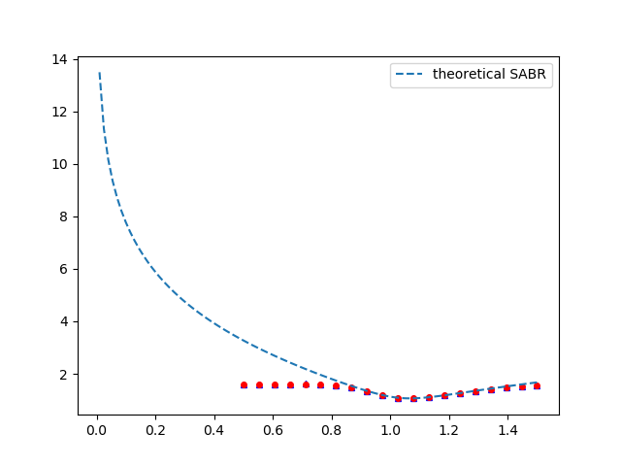
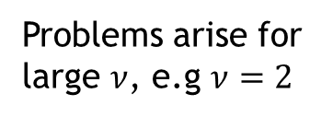
“Over the line” points
Problems arise for large $ν$, e.g $ν=2$

Slide 4
“Over the line” points
Problems arise for large $ν$, e.g $ν=2$
The problem must lie in the numerical procedure for calculating Black’s implied volatility

Slide 5

Black’s implied volatility numerical method
Newton Rahson’s method on vol
Minimizing Pricer(vol) – price of option
${vol}_{0}=\frac{\sqrt{2π T}p}{fD}$

Slide 6
Introduction
Industry standard optimization algorithm: Levenberg-Marquardt
It is a local optimization algorithm
Advantage: Fast
Disadvantage: May get stuck in local minima

Slide 7
Introduction
We can choose initial parameters to mitigate the disadvantages and amplify the advantages.
Initial parameters close to the final solution will increase speed of the algorithm and reduce the risk of it finging a local minimum along the way.

Slide 8


Levenberg Marquat Algorithm
Gradient descent
Gauss Newton
$h=c J^{⊺}W(f − \hat{f})$
${[J}^{⊺}WJ]h=J^{⊺}W(f − \hat{f})$
$${[J}^{⊺}WJ+λ I]h=J^{⊺}W(f − \hat{f})$$
Marquat’s update relationship

Slide 9

Levenberg Marquat Algorithm
${[J}^{⊺}WJ+λ I]h=J^{⊺}W(f − \hat{f})$
In our case $W=I$, since we don’t have access to the measurments errors nor the covariance matrix.
And so:
$[H+λ I]h=J (f − \hat{f})$

Slide 10
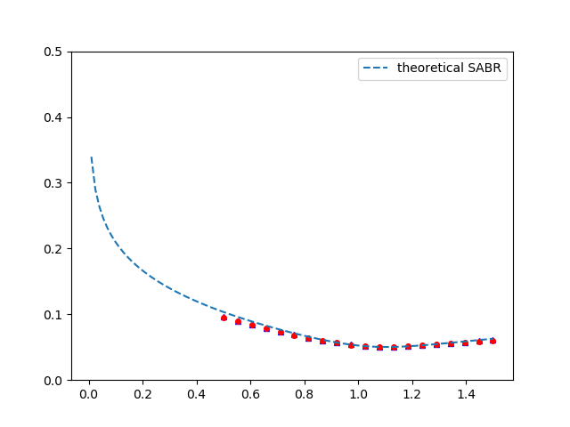
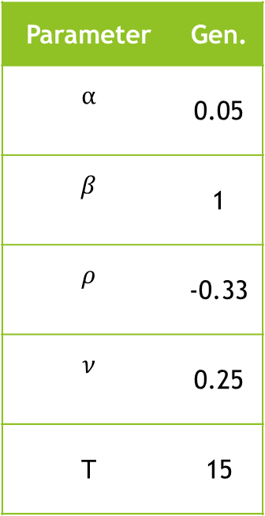


Levenberg Marquat Algorithm
Parameter | Gen.
$$α$$ | 0.05
$$β$$ | 1
$$ρ$$ | -0.33
$$ν$$ | 0.25
T | 15
European call
European put
Volatility ($σ$)
Normalized Strike ($\frac{K}{f_{0}}$)

Slide 11
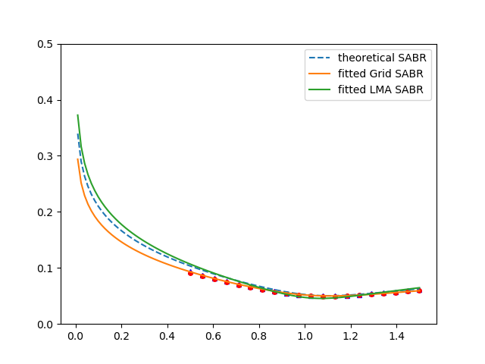
Levenberg Marquat Algorithm
Parameter | Gen.
$$α$$ | 0.05
$$β$$ | 1
$$ρ$$ | -0.33
$$ν$$ | 0.25
T | 15
European call
European put
Volatility ($σ$)
Normalized Strike ($\frac{K}{f_{0}}$)

Slide 12
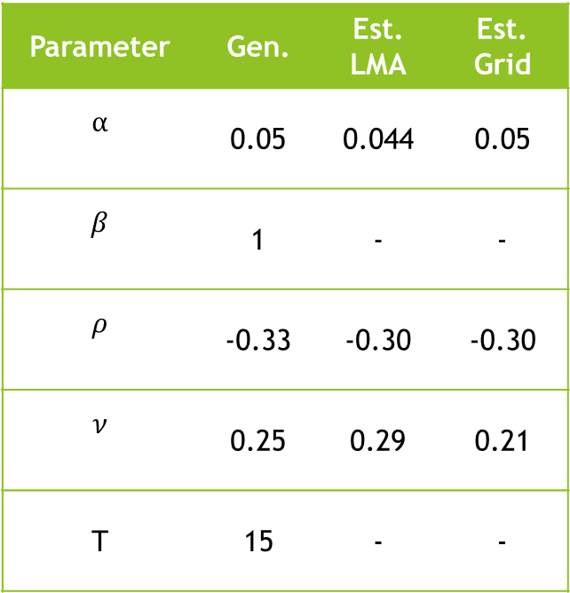
Levenberg Marquat Algorithm
Parameter | Gen. | Est. LMA | Est. Grid
$$α$$ | 0.05 | 0.044 | 0.05
$$β$$ | 1 | - | -
$$ρ$$ | -0.33 | -0.30 | -0.30
$$ν$$ | 0.25 | 0.29 | 0.21
T | 15 | - | -
European call
European put
Volatility ($σ$)
Normalized Strike ($\frac{K}{f_{0}}$)

Slide 13
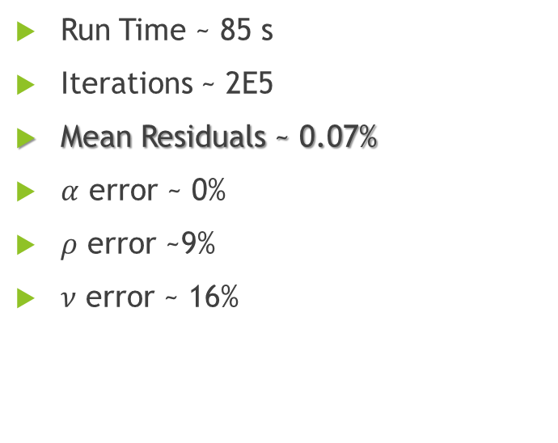
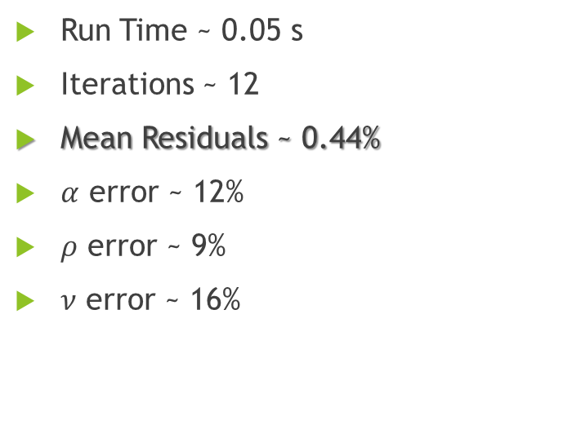
Levenberg Marquat Algorithm vs Grid Performance
LMA
Grid
Run Time ~ 0.05 s
Iterations ~ 12
Mean Residuals ~ 0.44%
$α$ error ~ 12%
$ρ$ error ~ 9%
$ν$ error ~ 16%
Run Time ~ 85 s
Iterations ~ 2E5
Mean Residuals ~ 0.07%
$α$ error ~ 0%
$ρ$ error ~9%
$ν$ error ~ 16%

Slide 14
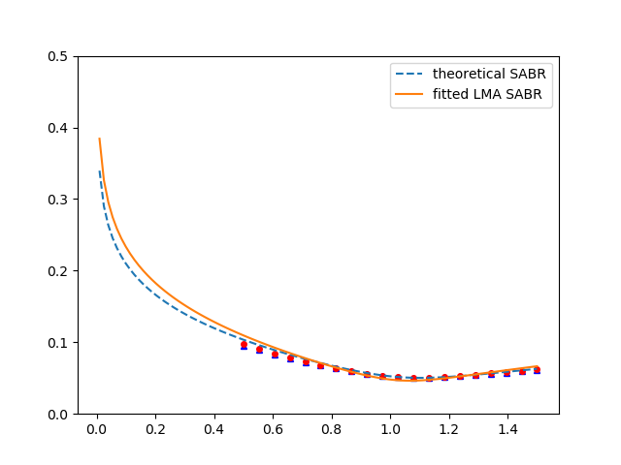

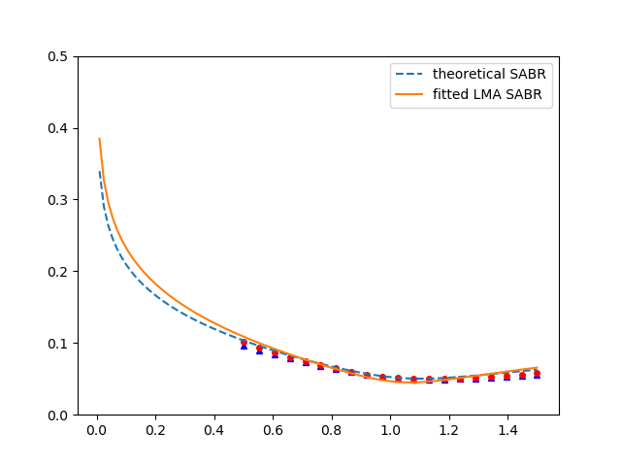
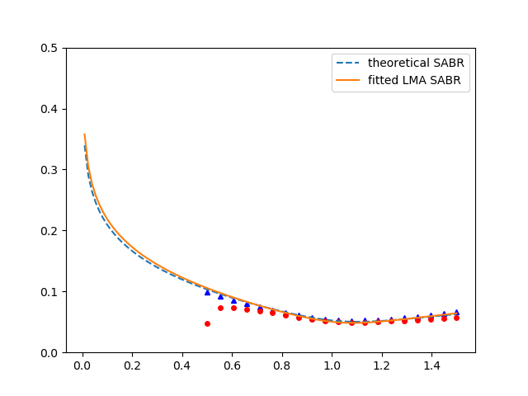
…more examples

Slide 15
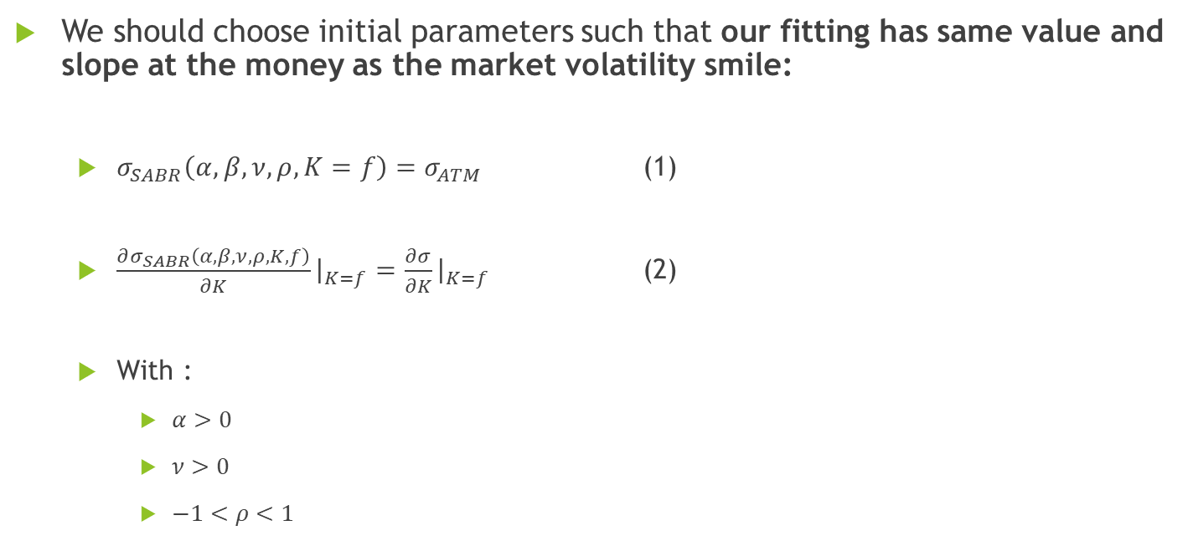
Smart parameters
We should choose initial parameters such that our fitting has same value and slope at the money as the market volatility smile:
$σ_{SABR}\left(α, β,ν, ρ, K=f\right)=σ_{ATM}$ (1)
$\frac{∂σ_{SABR}\left(α, β,ν, ρ, K, f\right)}{∂K}{\left.​\right|}_{K=f}=\frac{∂σ}{∂K}{\left.​\right|}_{K=f}$ (2)
With :
$α>0$
$ν>0$
$−1<ρ<1$

Slide 16
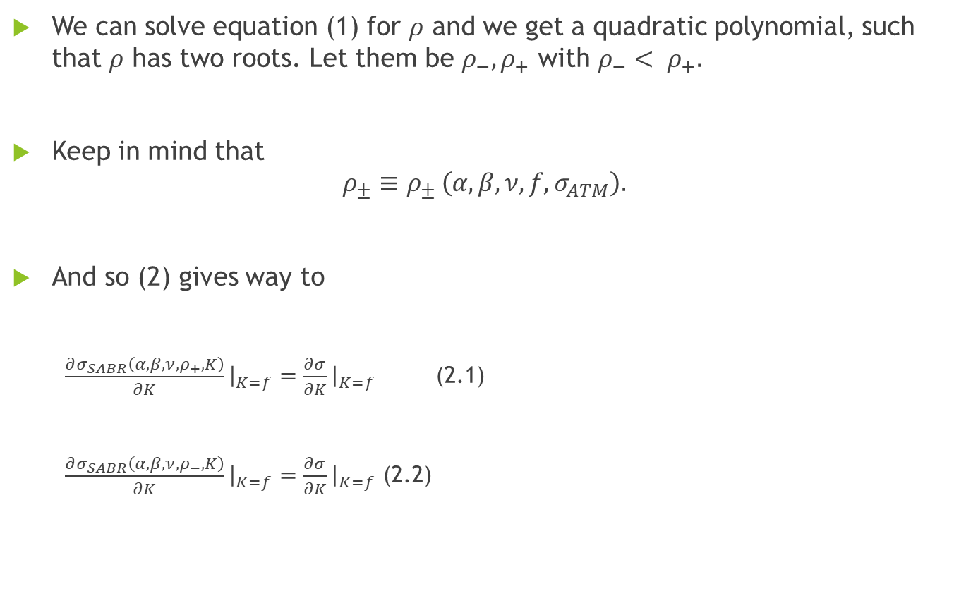
We can solve equation (1) for $ρ$ and we get a quadratic polynomial, such that $ρ$ has two roots. Let them be $ρ_{−}, ρ_{+}$ with $ρ_{−}< ρ_{+}.$
Keep in mind that
$$ρ_{±}≡ρ_{± }\left(α, β, ν, f, σ_{ATM}\right).$$
And so (2) gives way to
$\frac{∂σ_{SABR}\left(α, β,ν, ρ_{+}, K\right)}{∂K}{\left.​\right|}_{K=f}=\frac{∂σ}{∂K}{\left.​\right|}_{K=f}$ (2.1)
$\frac{∂σ_{SABR}\left(α, β,ν, ρ_{−}, K\right)}{∂K}{\left.​\right|}_{K=f}=\frac{∂σ}{∂K}{\left.​\right|}_{K=f}$ (2.2)

Slide 17
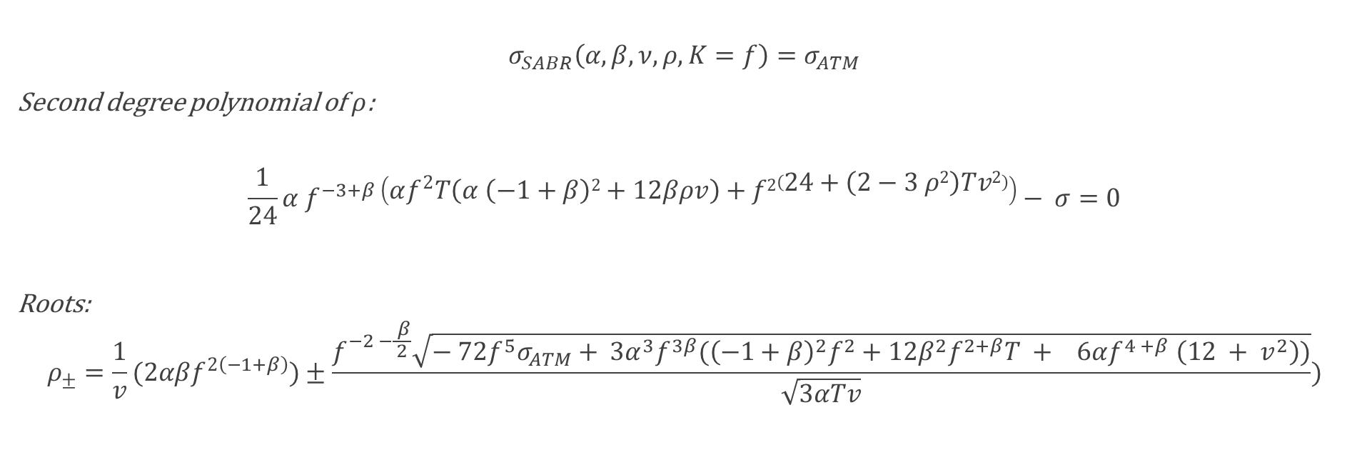

Smart Parameters: $ρ$
$$σ_{SABR}\left(α, β,ν, ρ, K=f\right)=σ_{ATM}$$
Second degree polynomial of $ρ$:
$$\frac{1}{24}α f^{−3+β}\left(αf^{2}T\left(α \left(−1+β\right)2+12βρv\right)+f2\left(24+\left(2−3 ρ2\right)Tv2\right)\right)− σ=0$$
Roots:
$$ρ_{±}=\frac{1}{v}(2αβf^{2\left(−1+β\right)})±\frac{f^{−2 −\frac{ β}{2}}\sqrt{− 72f^{5}σ_{ATM}+ {3α}^{3}f^{3β}({\left(−1+β\right)}^{2}f^{2}+12β^{2}f^{2+β}T + 6αf^{4 +β} \left(12 + v^{2}\right))}}{\sqrt{3αTv}})$$

Slide 18

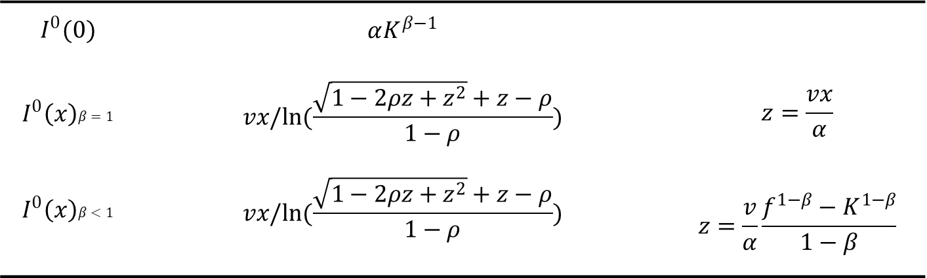


Smart Parameters System Scheme
$$I^{0} ≔I^{0}(x)$$
$$x=ln(\frac{f}{K})$$
(3)
$$I^{0}(0)$$ | $$αK^{β−1}$$
$$I^{0}\left(x\right)β=1$$ | $$vx/ln(\frac{\sqrt{1−2ρz+z^{2}}+z−ρ}{1−ρ})$$ | $$z=\frac{vx}{α}$$
$$I^{0}\left(x\right)β<1$$ | $$vx/ln(\frac{\sqrt{1−2ρz+z^{2}}+z−ρ}{1−ρ})$$ | $$z=\frac{v}{α}\frac{f^{1−β}−K^{1−β}}{1−β}$$
(4)
(5)
$$I^{1}\left(x\right)=\frac{{\left(β−1\right)}^{2}α^{2}}{24{\left(fK\right)}^{1−β}}+\frac{ρναρ}{4{\left(fK\right)}^{(1−β)/2}}+\frac{2−3ρ^{2}}{24}ν^{2}$$
$$σ_{SABR}\left(α, β,ν,ρ, K, f, T\right)=I^{0}\left(1+I^{1}T\right)$$

Slide 19
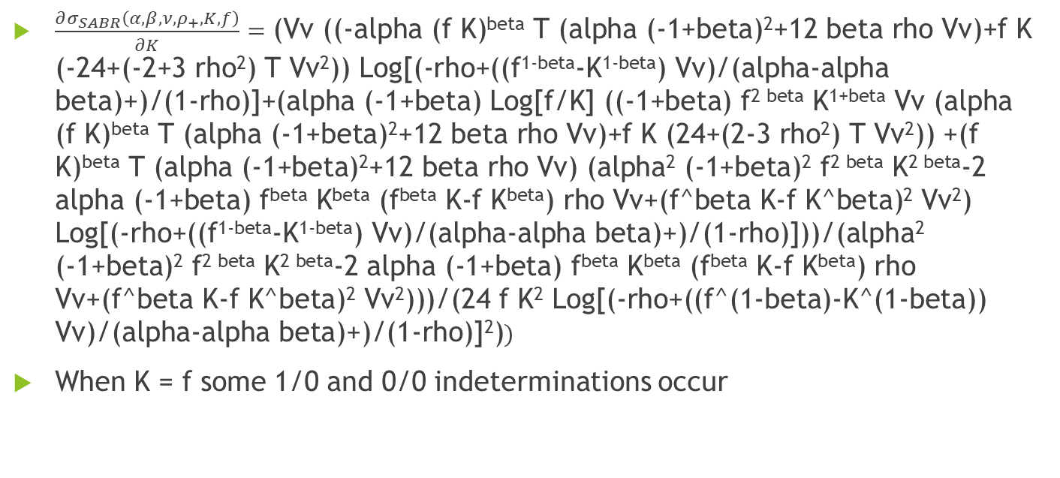

Computing (2.1) using (5) $(β<1$)
$\frac{∂σ_{SABR}\left(α, β,ν, ρ_{+}, K, f\right)}{∂K}=\text{(}\text{Vv}\text{ ((−}\text{alpha}\text{ (}\text{f} \text{K}\text{)}\text{beta} \text{T}\text{ (}\text{alpha}\text{ (−1+}\text{beta}\text{)2+12 }\text{beta} \text{rho} \text{Vv}\text{)+}\text{f} \text{K}\text{ (−24+(−2+3 }\text{rho}\text{2}\text{) }\text{T} \text{Vv}\text{2}\text{)) }\text{Log}\text{[(−}\text{rho}\text{+((}\text{f}\text{1−}\text{beta}\text{−}\text{K}\text{1−}\text{beta}\text{) }\text{Vv}\text{)/(}\text{alpha}\text{−}\text{alpha} \text{beta}\text{)+)/(1−}\text{rho}\text{)]+(}\text{alpha}\text{ (−1+}\text{beta}\text{) }\text{Log}\text{[}\text{f}\text{/}\text{K}\text{] ((−1+}\text{beta}\text{) }\text{f}\text{2 }\text{beta} \text{K}\text{1+}\text{beta} \text{Vv}\text{ (}\text{alpha}\text{ (}\text{f} \text{K}\text{)}\text{beta} \text{T}\text{ (}\text{alpha}\text{ (−1+}\text{beta}\text{)2+12 }\text{beta} \text{rho} \text{Vv}\text{)+}\text{f} \text{K}\text{ (24+(2−3 }\text{rho}\text{2}\text{) }\text{T} \text{Vv}\text{2}\text{)) +(}\text{f} \text{K}\text{)}\text{beta} \text{T}\text{ (}\text{alpha}\text{ (−1+}\text{beta}\text{)2+12 }\text{beta} \text{rho} \text{Vv}\text{) (}\text{alpha}\text{2}\text{ (−1+}\text{beta}\text{)2 }\text{f}\text{2 }\text{beta} \text{K}\text{2 }\text{beta}\text{−2 }\text{alpha}\text{ (−1+}\text{beta}\text{) }\text{fbeta} \text{Kbeta}\text{ (}\text{fbeta} \text{K}\text{−}\text{f} \text{Kbeta}\text{) }\text{rho} \text{Vv}\text{+(}\text{f}\text{^}\text{beta} \text{K}\text{−}\text{f} \text{K}\text{^}\text{beta}\text{)2 }\text{Vv}\text{2}\text{) }\text{Log}\text{[(−}\text{rho}\text{+((}\text{f}\text{1−}\text{beta}\text{−}\text{K}\text{1−}\text{beta}\text{) }\text{Vv}\text{)/(}\text{alpha}\text{−}\text{alpha} \text{beta}\text{)+)/(1−}\text{rho}\text{)]))/(}\text{alpha}\text{2}\text{ (−1+}\text{beta}\text{)2 }\text{f}\text{2 }\text{beta} \text{K}\text{2 }\text{beta}\text{−2 }\text{alpha}\text{ (−1+}\text{beta}\text{) }\text{fbeta} \text{Kbeta}\text{ (}\text{fbeta} \text{K}\text{−}\text{f} \text{Kbeta}\text{) }\text{rho} \text{Vv}\text{+(}\text{f}\text{^}\text{beta} \text{K}\text{−}\text{f} \text{K}\text{^}\text{beta}\text{)2 }\text{Vv}\text{2}\text{)))/(24 }\text{f} \text{K}\text{2} \text{Log}\text{[(−}\text{rho}\text{+((}\text{f}\text{^(1−}\text{beta}\text{)−}\text{K}\text{^(1−}\text{beta}\text{)) }\text{Vv}\text{)/(}\text{alpha}\text{−}\text{alpha} \text{beta}\text{)+)/(1−}\text{rho}\text{)]2)})$
When K = f some 1/0 and 0/0 indeterminations occur

Slide 20


Computing (2.1) using (3) $(x=0$)
$\frac{∂σ_{SABR}\left(α, β,ν, ρ, K, f\right)}{∂K}$ = $\frac{α\left(−1+β\right)K^{−3+β} (2α(fK)β T (α (−1+β)2+12 βρv)+fK(24+(2−3 ρ2) Tv2)))}{24αfK2}$
K = f
$$\frac{−∂σ_{SABR}\left(α, β,ν,ρ, K, f\right)}{∂K}{\left.​\right|}_{K=f}=\frac{1}{24}α \left(−1+β\right)f^{−4+β} \left(2αf^{2β} T\left(α\left(−1+β\right)2+12βρv\right)+f2\left(24+\left(2−3ρ2\right)Tv2\right)\right)$$
Solving this system of equations for both rhos in leaves me with complex roots for alpha and v.

Slide 21
Smart Parameters Bounds Scheme
Choose $ν_{0}$
Choose 𝜈_0
Deduce $α$ bounds
Deduce 𝛼 bounds
Find root $α_{0}$
Find root 𝛼_0
Compute $ρ_{0}$
Compute 𝜌_0
In case of no solution, choose new $ν_{0}$
In case of no solution, choose new 𝜈_0

Slide 22
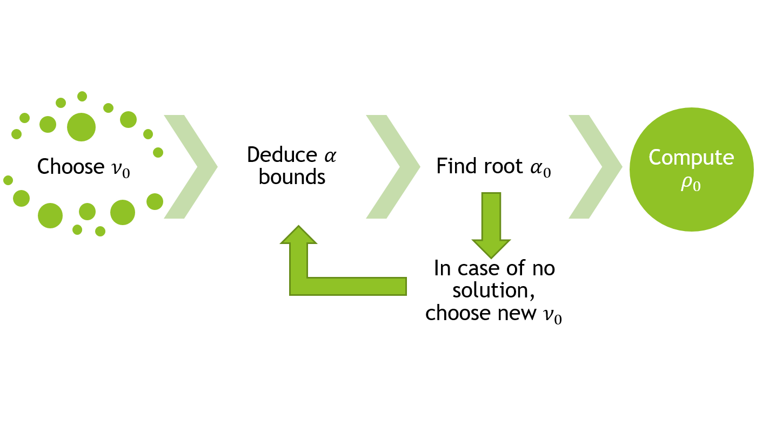
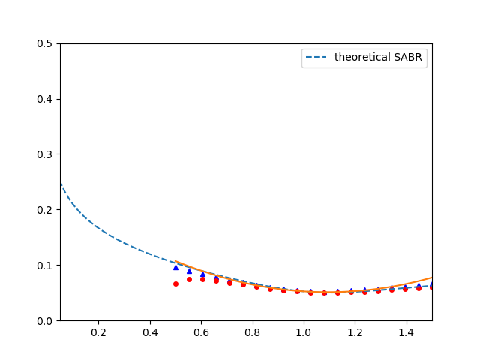
Smart Parameters
Parameter | Gen.
$$α$$ | 0.05
$$β$$ | 1
$$ρ$$ | -0.33
$$ν$$ | 0.25
T | 15
quadratic aprox ATM
European call
European put
Volatility ($σ$)
Normalized Strike ($\frac{K}{f_{0}}$)

Slide 23

Smart Parameters
Parameter | Gen.
$$α$$ | 0.05
$$β$$ | 1
$$ρ$$ | -0.33
$$ν$$ | 0.25
T | 15
quadratic aprox ATM
European call
European put
Volatility ($σ$)
$${\hat{σ}}_{ATM}$$
Normalized Strike ($\frac{K}{f_{0}}$)

Slide 24
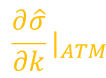
Smart Parameters
Parameter | Gen.
$$α$$ | 0.05
$$β$$ | 1
$$ρ$$ | -0.33
$$ν$$ | 0.25
T | 15
quadratic aprox ATM
European call
European put
Volatility ($σ$)
$${\frac{∂\hat{σ}}{∂k}|}_{ATM}$$
Normalized Strike ($\frac{K}{f_{0}}$)

Slide 25
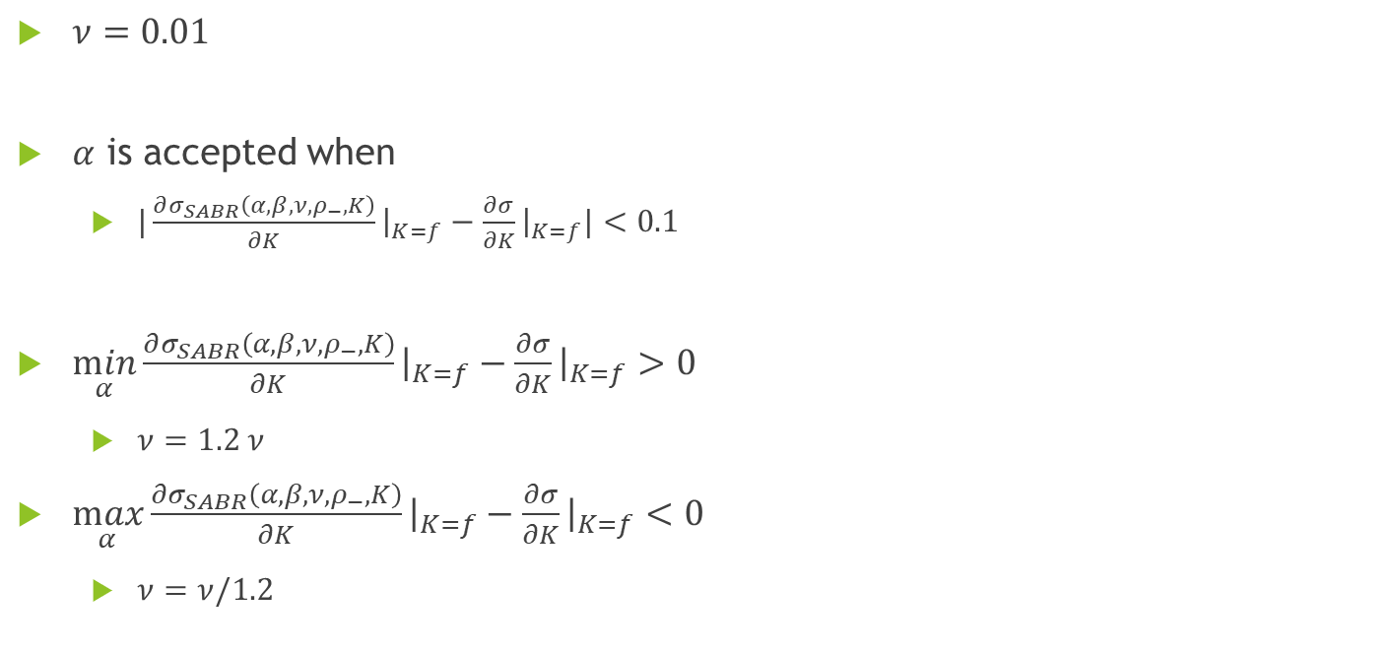
Smart Parameters - Remarkable assumptions
$ν=0.01$
$α$ is accepted when
$|\frac{∂σ_{SABR}\left(α, β,ν, ρ_{−}, K\right)}{∂K}{\left.​\right|}_{K=f}−\frac{∂σ}{∂K}{\left.​\right|}_{K=f}|<0.1$
$\min_{α}{\frac{∂σ_{SABR}\left(α, β,ν, ρ_{−}, K\right)}{∂K}{\left.​\right|}_{K=f}−\frac{∂σ}{∂K}{\left.​\right|}_{K=f}}>0$
$ν=1.2 ν$
$\max_{α}{\frac{∂σ_{SABR}\left(α, β,ν, ρ_{−}, K\right)}{∂K}{\left.​\right|}_{K=f}−\frac{∂σ}{∂K}{\left.​\right|}_{K=f}}<0$
$ν=ν/1.2$

